Slide 1
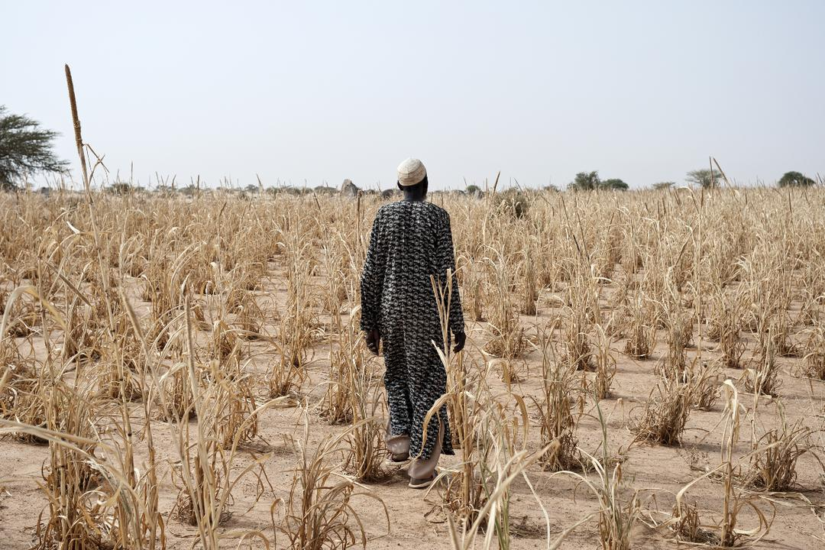
Building Inclusive Early Warning Systems:
A Community-Centered Approach in Sudan
Maysoon Badi
Sudan Urban Development Think Tank

Slide 2
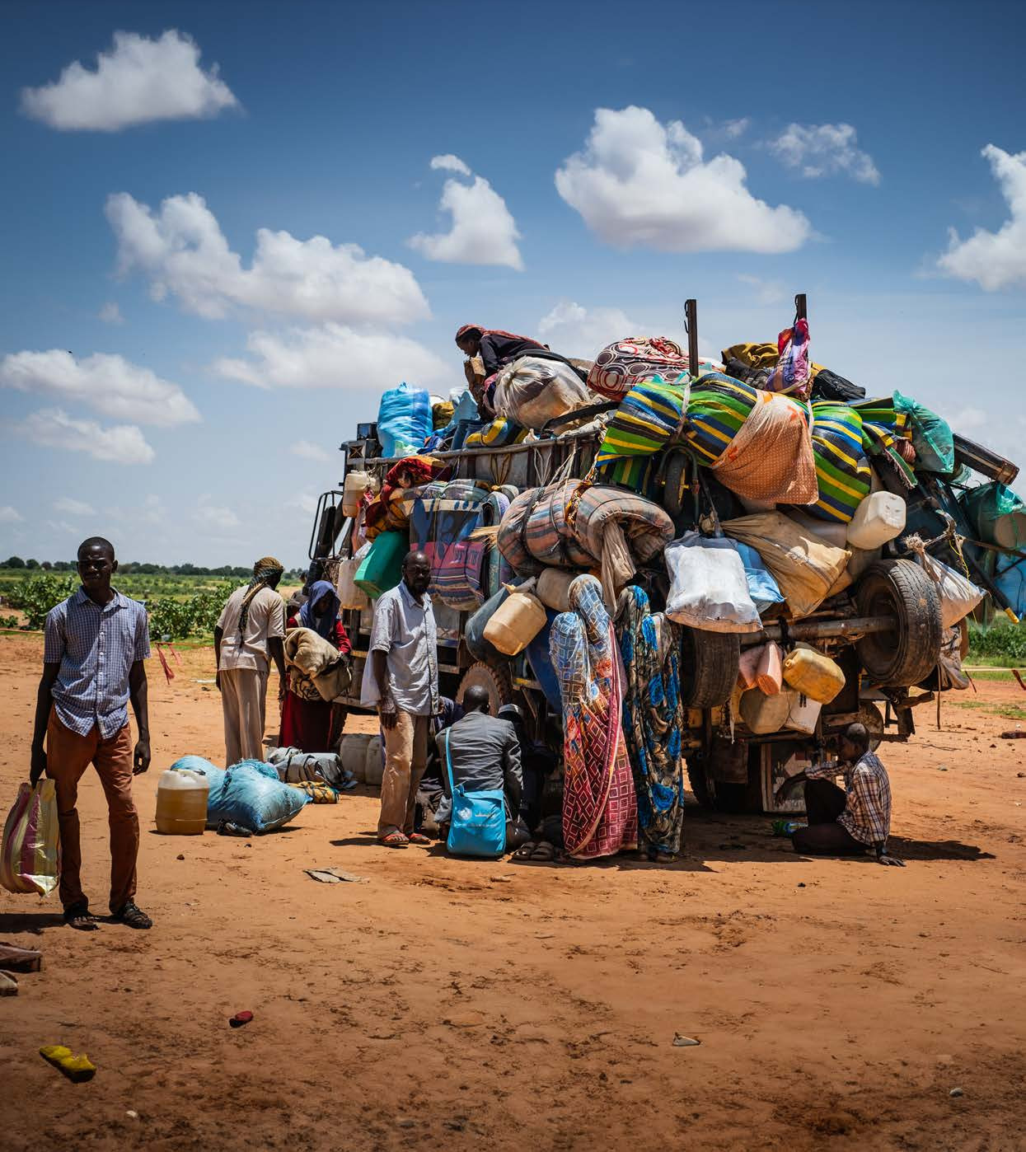
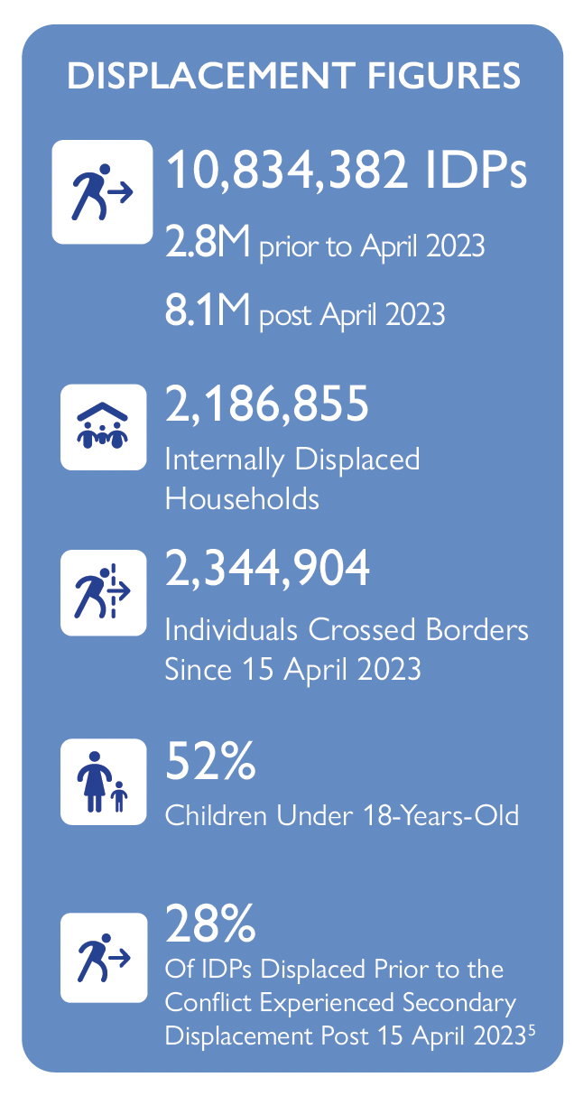
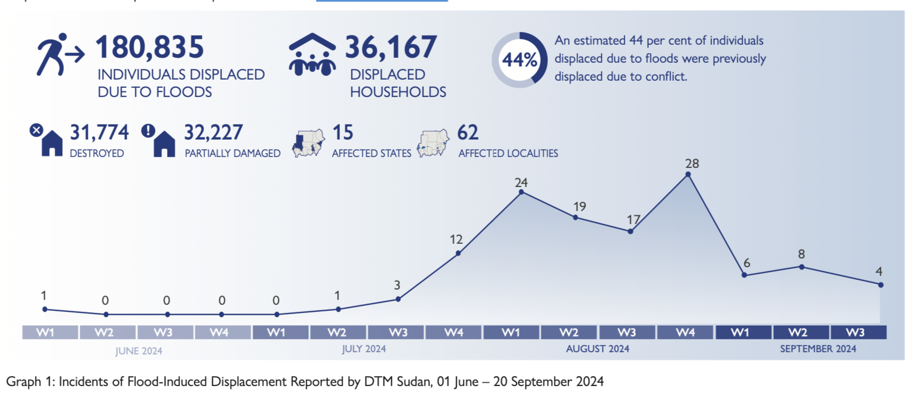

Sudan Overview
10 September 2024
20%
of the population was displaced since 15 April 2023
90%
of IDP households could reportedly not afford food
97%
(Nearly all) IDPs were in localities with high levels of acute food insecurity or worse (IPC level 3+).
Flood-Induced Displacement
01 June-20 September 2024
already displaced due to conflict prior to the onset of floods.
44%

Slide 3









- Sudan Emergency Forecast and Early Warning Service
Forecasters
Knowledge Partner
Community Partner
Sponsor

Slide 4




- Sudan Emergency Forecast and Early Warning Service
Target Users
At-risk communities in conflict-affected areas, IDPs and Host communities, particularly in regions where seasonal rains and flash floods pose significant risks.
The humanitarian responders providing assistance, including UN agencies and INGOs.
communities engaged in farming and livestock herding.

Slide 5



- Sudan Emergency Forecast and Early Warning Service
Services
National overview forecasts and location-specific forecasts in daily and in weekly mode in urban and suburban areas.
Seasonal and subseasonal forecasts relating to planting and harvesting decisions.
Early warnings related to evacuation, health, food, logistics and others.
!

Slide 6
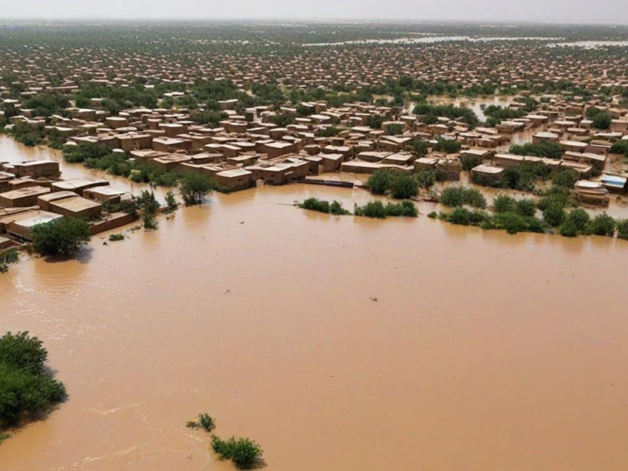
INFORMATION
MESSAGES
COMMUNICATION CHANNELS
Capacity Building
Accurate/Reliable
Downscaled
Relevant
Co-production
- Sudan Emergency Forecast and Early Warning Service

Slide 7
INFORMATION
MESSAGE
COMMUNICATION CHANNELS
Easy Language
Understandable
Simple Icons
Impact-based
Actionable
Self-help Advice
- Sudan Emergency Forecast and Early Warning Service

Slide 8
INFORMATION
MESSAGES
COMMUNICATION CHANNELS
Multiple Channels
Wide Reach
Existing Channels
Trusted
Culturally Informed
- Sudan Emergency Forecast and Early Warning Service

Slide 9
INFORMATION
MESSAGES
COMMUNICATION CHANNELS
Accurate/Reliable
Understandable
Wide Reach
Relevant
Actionable
Trusted
USERS
Co-production
User-centered
Feedback Channels
- Sudan Emergency Forecast and Early Warning Service
Notes:
One cannot pretend to help protect or save lives and livelihoods, reduce losses and build resilience without a proper consideration of and alignment to the lifestyles and realities of the people it serves.
AA interventions design must pay attention to the generation of new information, experiences and learning for and with communities, in ways that motivate and value their participation.

Slide 10
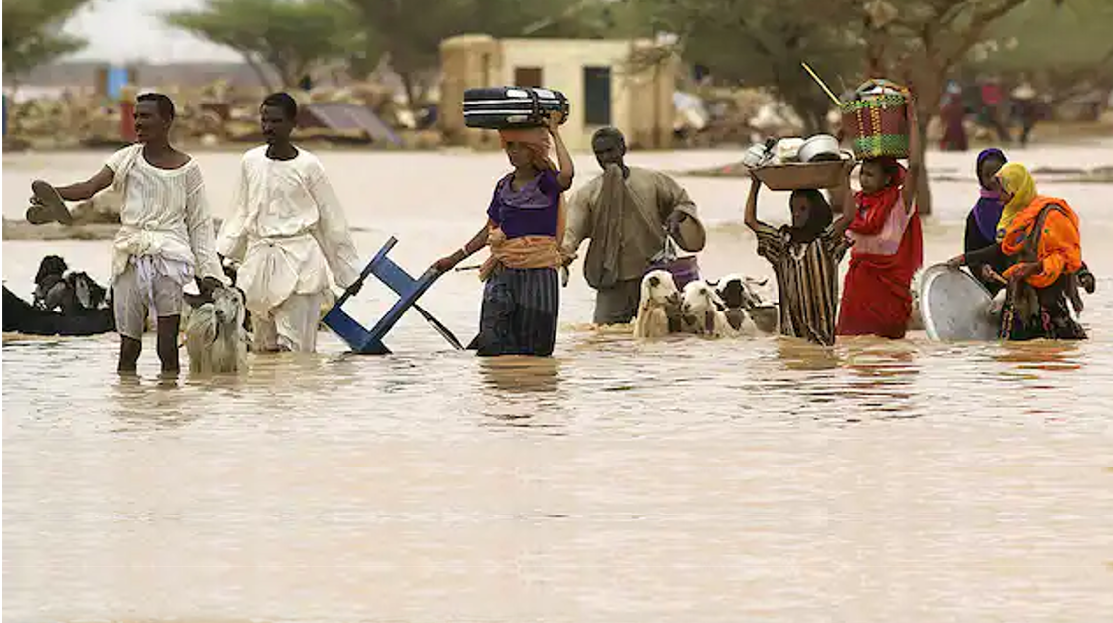
Is information Enough?
- Sudan Emergency Forecast and Early Warning Service

Slide 11
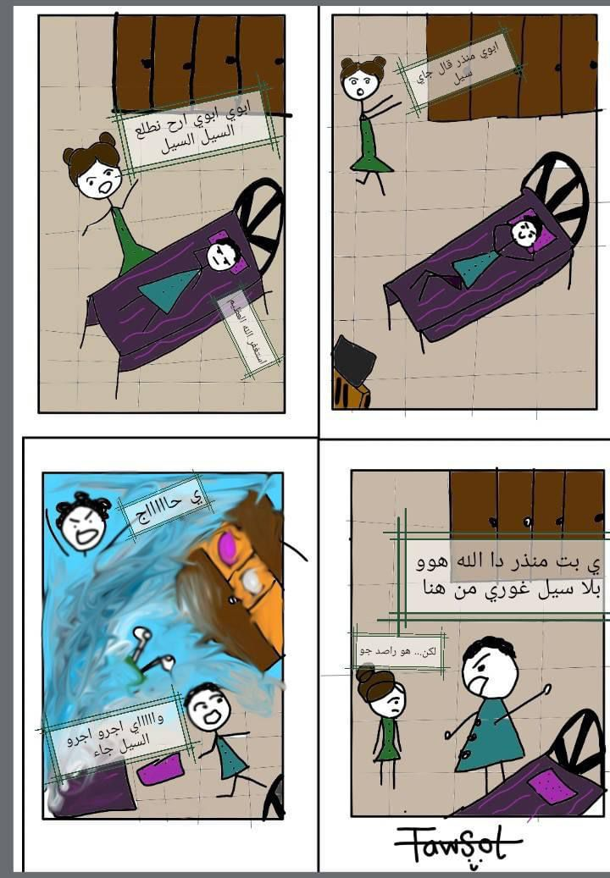
25 minutes
DAD, the weather man said a FLOOD IS COMING
DAD! DAD! Hurry up! FLOODS, FLOODS!
Scenario 2 – Sudan
What if early warning does not lead to early action?
Scenario: Despite receiving timely early warnings about an impending flood, the community did not act due to cultural misconceptions and mistrust. This resulted in damages, displacement, and loss of livelihoods.
Key Challenge: How can early warning systems be improved to overcome cultural barriers and ensure vulnerable communities trust and act on the information provided?
Now what!
HUSBAAAAND!
He ain’t GOD, Go away and don’t bother me again!
But Dad...
He is a WEATHER FORECASTER
AHHHH! RUN! RUN for your lives
2024

Slide 12
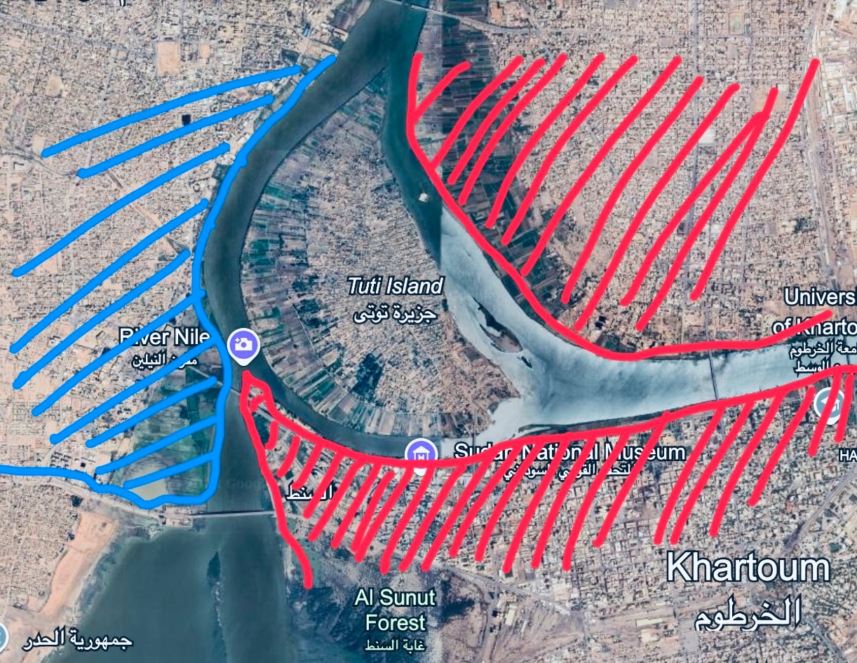
Scenario – Sudan
How can we trigger anticipatory action ?
In conflict-affected areas, people face many challenges that make it hard for them to prepare for climate hazards. Restricted movement and limited resources prevent communities from taking necessary precautions.

